Slide 1
IS CLIMATE CHANGE A MYTH?
By
Sindhu Ethamukkala

Slide 2
About the project/GOALS
Why is this study important?
There are strong claims that global warming is happening rapidly and is already having significant and harmful effects on our communities, our health, and our climate.
But there are other arguments that are completely against this claim. To find out if global warming is a real phenomenon, it is important to analyze the Earth surface temperature data over considerable time.
This study is an attempt to find answers to the following questions:
If the temperature change over the years is a natural process or an unexpected trend
If there is an unusual temperature pattern for one or more countries that can provide us with more insights about human intervention

Slide 3
DATASET
Data source: Kaggle.com
Link: https://www.kaggle.com/berkeleyearth/climate-change-earth-surface-temperature-data#GlobalLandTemperaturesByCountry.csv
Number of files used: 2

Slide 4
About the data
GlobalTemperatures.csv:
Columns: dt, LandAverageTemperatureUncertainty, LandMaxTemperature, LandMaxTemperatureUncertainty, LandMinTemperature, LandMinTemperatureUncertainty, LandAndOceanAverageTemperature, LandAndOceanAverageTemperatureUncertainty, LandAverageTemperature (target variable)
No of records: 3192
Missing values for target variable: 12
GlobalLandTemperaturesByCountry.csv:
Columns: dt, AverageTemperatureUncertainty, Country, AverageTemperature (target variable)
No of records: 577462
Missing values for target variable: 32651

Slide 5
DATA CLEANING
Both datasets had null values for the target variables and they were fixed by 2 methods:
Interpolate
Averaging existing values around the null value
There is average temperature uncertainty column for both datasets. To minimize error, some of the initial rows where uncertainty was above +/- 2 degrees (till 1830s) were removed
Except for dt and average Temperature columns, all the other columns were removed as large percentage of values were missing. Hence, this is a univariate analysis
Numbers of rows for global data after cleaning: 2192

Slide 6
GOAL 1 - APPROACH
Our first goal is to find out if the temperature change over the years is a natural process or an unexpected trend.
Steps:
Since this is a time series analysis, dt field (date) was converted into index
Data imputation was performed – by interpolation
Data decomposition was done to find out about seasonality and trend
Stationarity test (Dickey-Fuller) was conducted to check if the data is stationary
4 models were applied to forecast temperatures
Trend graph is plotted with future values
Notes:
We have information about article types and about when they got published. We also know what articles were popular.
Now the challenge here is to relate topics with their published days based on the popularity. In other words, I want to figure out how to maximize the popularity of an article by finding out on what days popular articles types were published.

Slide 7
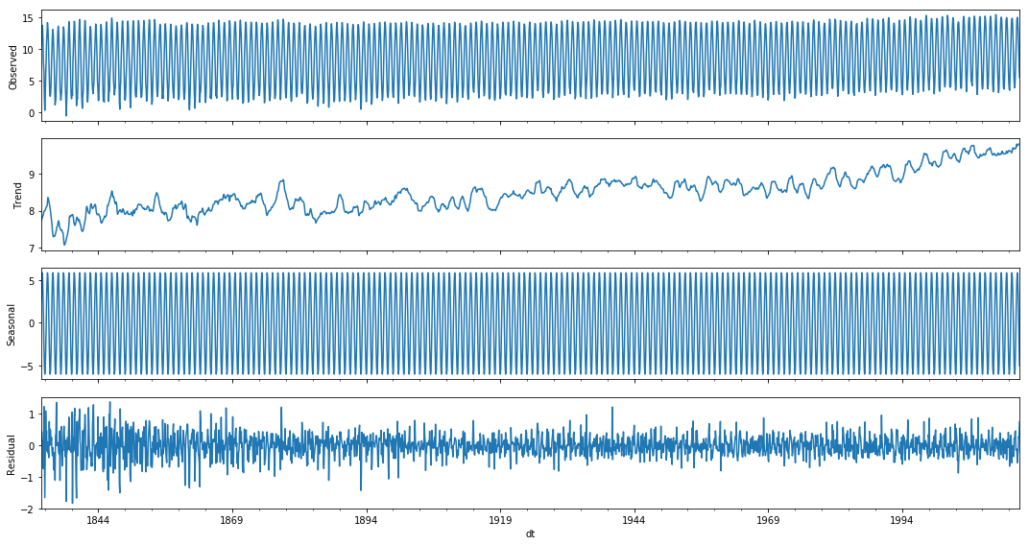
GOAL 1 – SEASONALITY AND TREND
Using visualization
Using seasonal decompose
Using stationarity test
Notes:
We have information about article types and about when they got published. We also know what articles were popular.
Now the challenge here is to relate topics with their published days based on the popularity. In other words, I want to figure out how to maximize the popularity of an article by finding out on what days popular articles types were published.

Slide 8
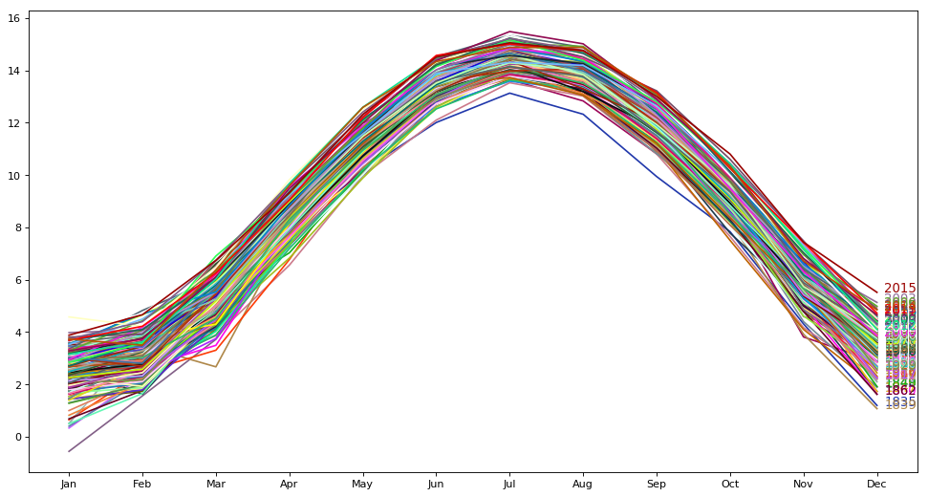
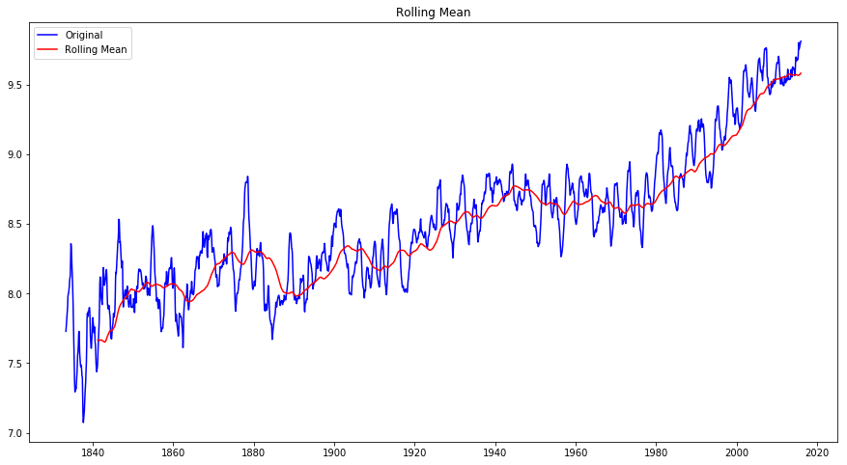
GOAL 1 – SEASONALITY AND TREND
The image depicts seasonality in the data by following a similar pattern every month year by year
There is a clear upward trend to the data that drastically spiked from late 1900s
Notes:
We have information about article types and about when they got published. We also know what articles were popular.
Now the challenge here is to relate topics with their published days based on the popularity. In other words, I want to figure out how to maximize the popularity of an article by finding out on what days popular articles types were published.

Slide 9
GOAL 1 - models
4 models were selected to predict future values:
Two from time series analysis family
SARIMAX
Holt winters ExponentialSmoothing
Two from Supervised learning models
Linear Regression
Random Forest regressor
Hyperparameter tuning was applied to SARIMAX and Random Forest Regressor
Feature Engineering was done by adding Month, Year, one month lag and one year lag to the data for Supervised learning models
Notes:
We have information about article types and about when they got published. We also know what articles were popular.
Now the challenge here is to relate topics with their published days based on the popularity. In other words, I want to figure out how to maximize the popularity of an article by finding out on what days popular articles types were published.

Slide 10
GOAL 1 - models
MODEL | MEAN R-SQUARED | MEAN RMSE
SARIMAX | 0.98 | 0.566
EXPONENTIAL SMOOTHING | 0.98 | 0.48
LINEAR REGRESSION | 0.98 | 0.45
RANDOM FOREST REGRESSOR | 0.98 | 0.44
From the above table, all models seem to work pretty well with minute differences in RMSE.
Exponential Smoothing and Random Forest Regressor were selected for the final predictions.
Notes:
We have information about article types and about when they got published. We also know what articles were popular.
Now the challenge here is to relate topics with their published days based on the popularity. In other words, I want to figure out how to maximize the popularity of an article by finding out on what days popular articles types were published.

Slide 11
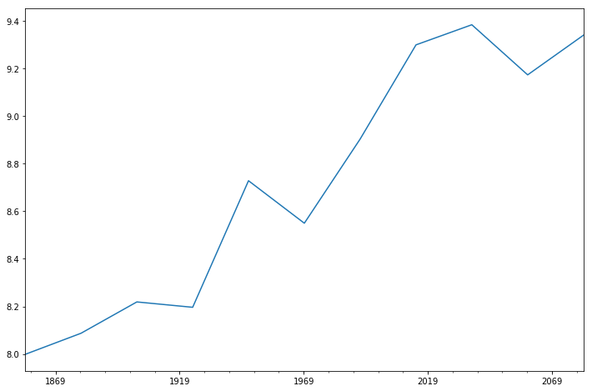
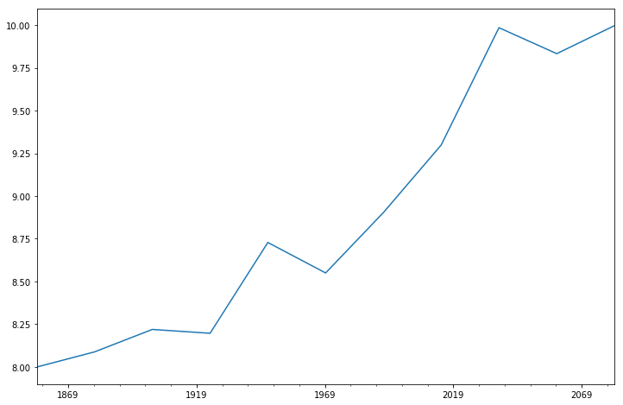
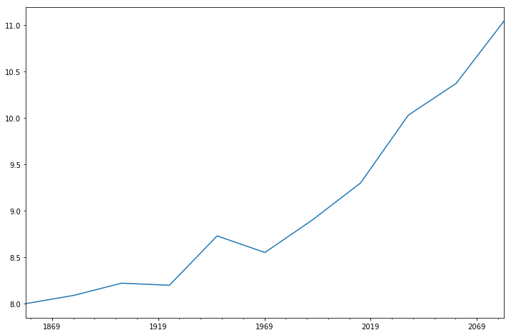
GOAL 1 – model Predictions
Random Forest Regressor Prediction
Exponential Smoothing Prediction
SARIMAX Prediction
Notes:
We have information about article types and about when they got published. We also know what articles were popular.
Now the challenge here is to relate topics with their published days based on the popularity. In other words, I want to figure out how to maximize the popularity of an article by finding out on what days popular articles types were published.

Slide 12
GOAL 1 - conclusion
Of all the future trends predicted by the 3 models, prediction from Exponential Smoothing model seems promising.
But any model in general is predicting an upward trend in global temperatures and it looks as if Global Warming is inevitable if no measures are taken.
Hence, this analysis strongly indicates a recent sudden rise in temperatures and the forecast supports this trend.

Slide 13
GOAL 2 – approach
Our second goal is to find out if there is an unusual temperature pattern for one or more countries.
Steps:
A list of 10 countries have been selected for this analysis.
Top 5 countries claimed as global warming contributors: China, United States, India, Russia, Japan
Other countries: Mexico, Chile, Libya, Morocco, Australia
Data imputation was performed on the countries listed above – by custom function
Individual Data frames were created for each country
Trend plots were plotted separately for each group of countries

Slide 14
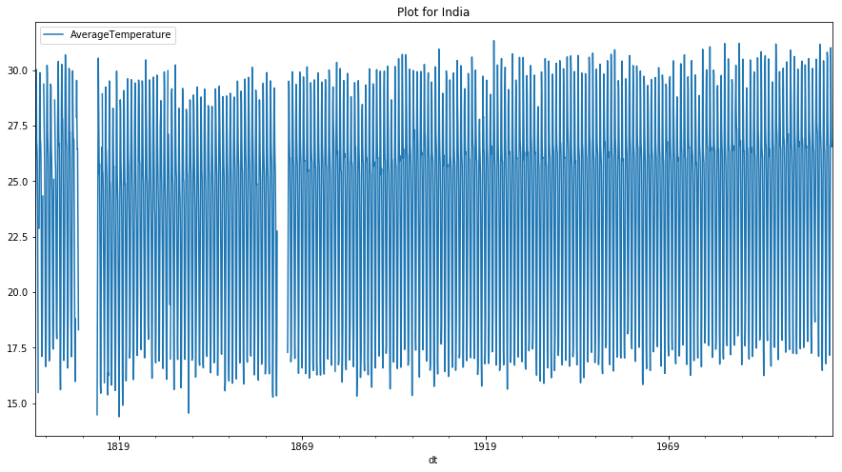
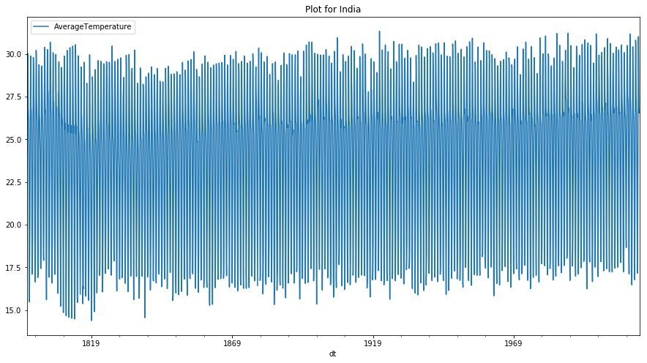
GOAL 2 – DATA IMPUTATION
Implemented using a custom function
BEFORE IMPUTATION (for India)
AFTER IMPUTATION (for India)
Notes:
To binarize the data, I used the shares value of 50% data (1400) as a cutoff between popular and not popular and added a new column ‘isPopular’ to store those new values.
To accomplish this goal, I had to pivot topics and weekdays columns to show each group in one column.
Then I grouped the data 1st by Weekday, then by topic and aggregated the isPopular column by count and sum. This enabled me to calculate the percentage of popular articles. This was all I needed to come up with this bar plot.

Slide 15
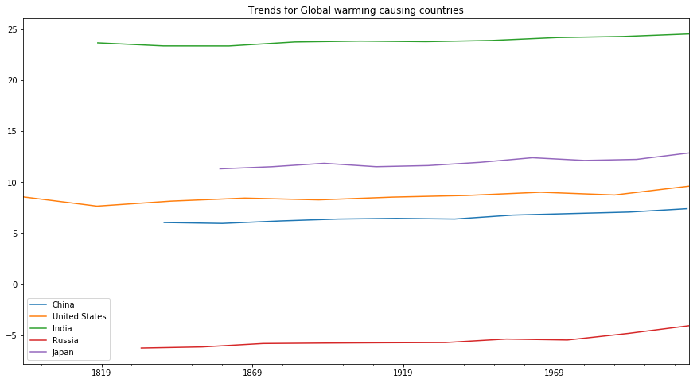
GOAL 2 – TRENDS for global warming causing countries

Slide 16
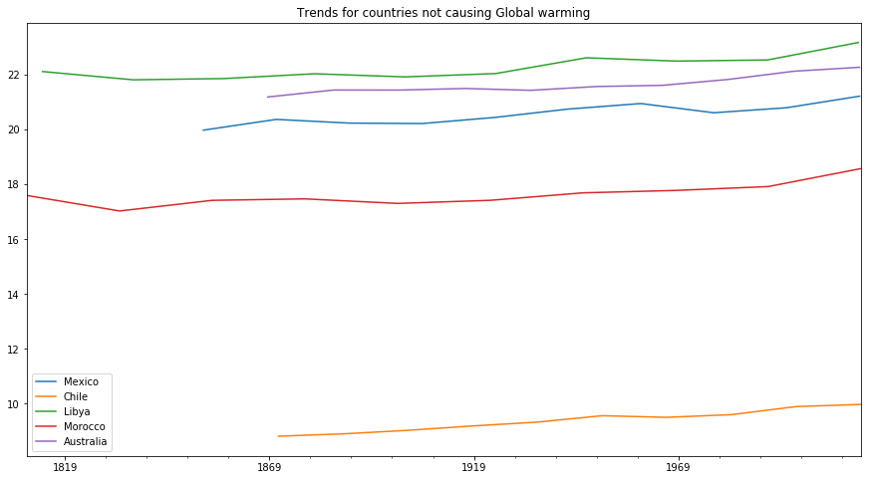
GOAL 2 – TRENDS for countries not responsible for global warming

Slide 17
GOAL 2 - conclusion
Most of the countries, troublemakers and non-troublemakers, are following similar temperature patterns.
There is a steady rise in temperatures till late 1990s and then the a steep spike.

Slide 18
challenges and improvements
Challenges:
Handling missing data
Validating information since the data is available from the year 1750
Forecasting temperatures using Supervised learning models
Improvements:
Could implement more models and check their predictions
Multivariate modeling

Slide 19
Questions?

